Slide 1
Analysis of Avocado Sales
Dianna Sinicrope
DSC530 Final Project

Slide 2
The Data
Represents Haas avocado sales recorded on various days from 2015 to 2018.
Collected and released by the Hass Avocado Board.
Link to data: https://www.kaggle.com/neuromusic/avocado-prices

Slide 3
The Questions
Do organic avocados cost more?
Does the cost of organic avocados relate to the cost of conventionally grown avocados?

Slide 4
Important Variables
Average Price- the average price of avocados for that day in that region.
Date- the date the variable was recorded.
Total Volume- the number of avocados sold.
Type- a binary variable for organic vs. conventional avocados.
Region- the city in which the recording for that day occurred.
PLU columns- The PLU sticker number on each avocado sold represents how big the avocado is. PLU 4046 is for small, 4225 for large, and 4770 for extra large avocados.

Slide 5
Price Histogram
Price (rounded to the nearest .1), has a slight right skew, with the majority of prices between $1 and $2.
$6 BILLIONS
$4 BILLIONS
$900,000

Slide 6
Volume Histogram
The volume of avocados sold don’t vary greatly.
$6 BILLIONS
$4 BILLIONS
$900,000

Slide 7
Small Avocados Histogram
The volume of small avocados sold don’t vary greatly.
$6 BILLIONS
$4 BILLIONS
$900,000

Slide 8
Large Avocados Histogram
The volume of large avocados sold don’t vary greatly.
$6 BILLIONS
$4 BILLIONS
$900,000

Slide 9
XL Avocados Histogram
The volume of xl avocados sold don’t vary greatly.
$6 BILLIONS
$4 BILLIONS
$900,000

Slide 10
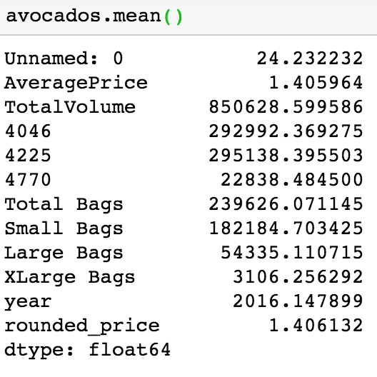
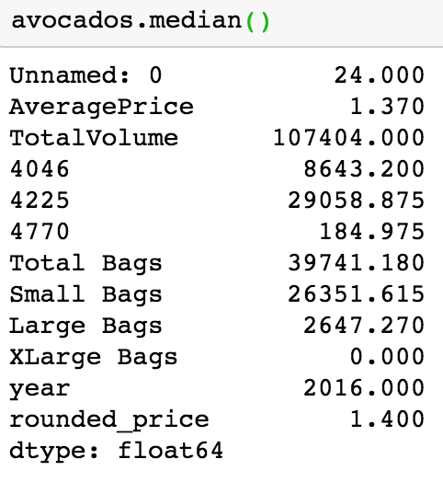
Central Tendency
Mean shows that the average price of avocados in this study was about $1.41. A slight caution should be taken since this calculation was an average of averages.
The median average price was slightly lower, $1.37, and supports the right skew shown in the price histogram.
$6 BILLIONS
$4 BILLIONS
$900,000

Slide 11
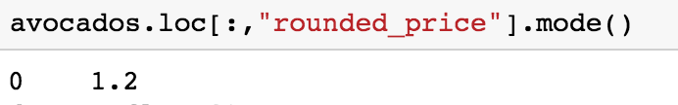
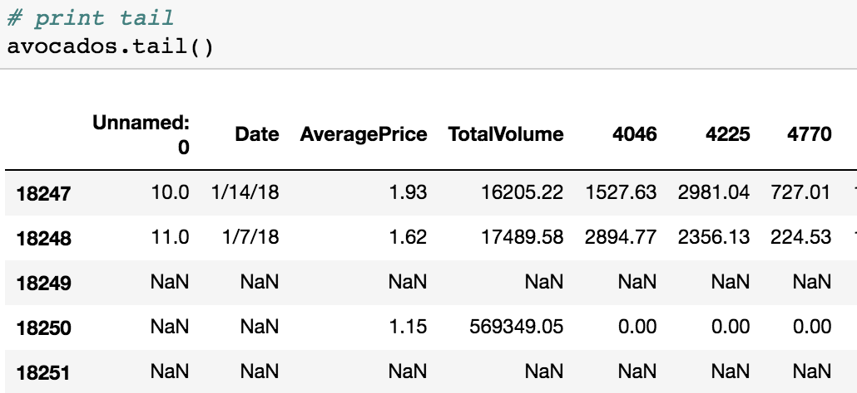
Central Tendency
The mode of prices is $1.20 per avocado.
Here’s the tail of the dataset based on date.
$6 BILLIONS
$4 BILLIONS

Slide 12
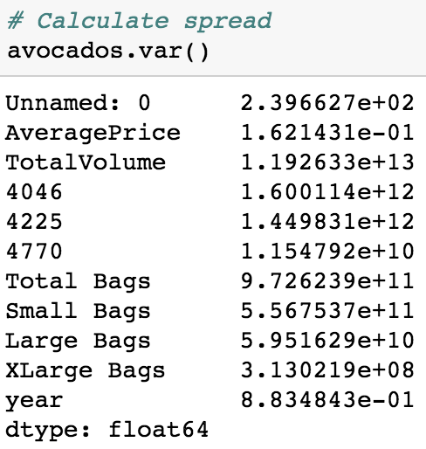
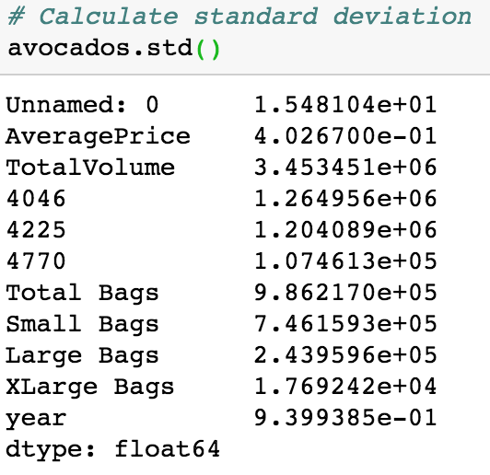
Central Tendency
Average price has a low variance, which means the data points aren’t spread out very far from the mean. The volume variables though, have higher variances, showing that they are further from the mean.
The standard deviation calculations also show that the average price measurements are not spread out far from the mean.
$6 BILLIONS
$4 BILLIONS

Slide 13
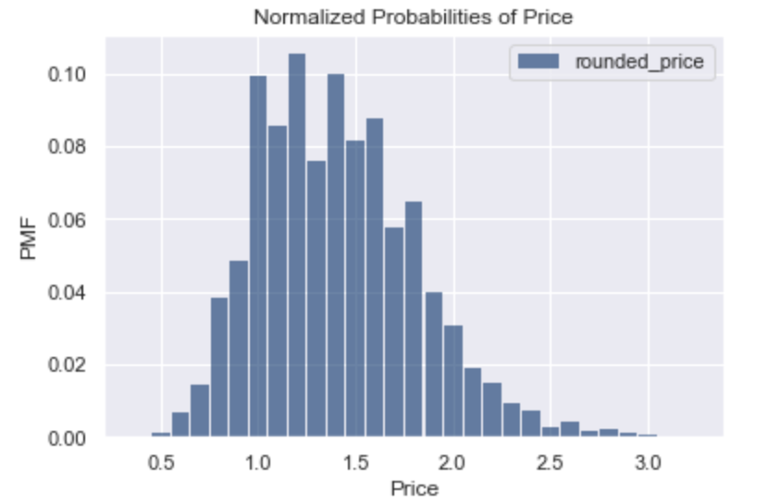
Normalized Probabilities of Price
Here are the probabilities of prices.
$6 BILLIONS
$4 BILLIONS
$900,000

Slide 14
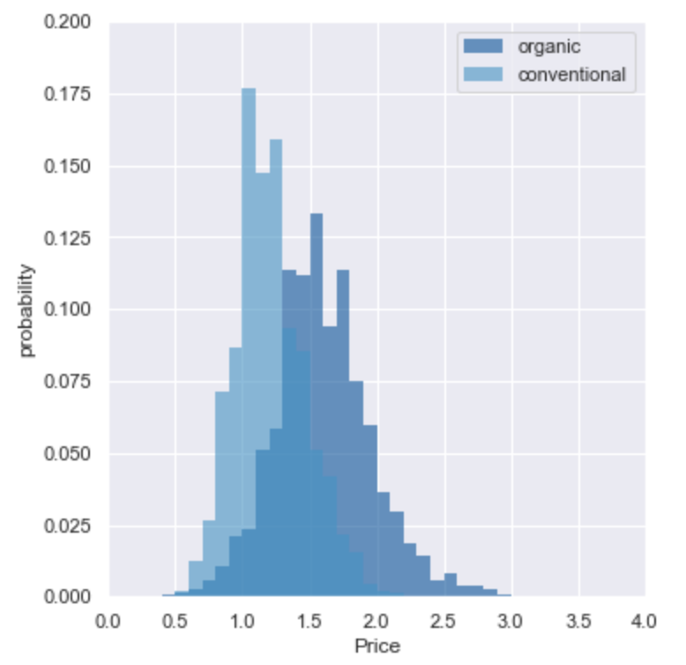
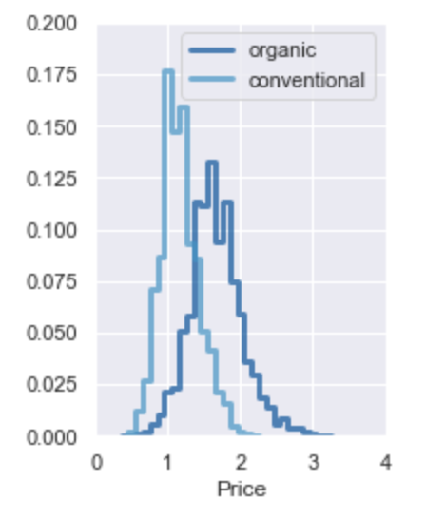
Comparing Organic vs. Conventional Avocados
These two charts show the probabilities of prices for organic avocados vs. conventional avocados.
While these two charts show the same information, the chart on the left uses bar graphs and the chart on the right uses step functions.
$6 BILLIONS
$4 BILLIONS
$900,000

Slide 15
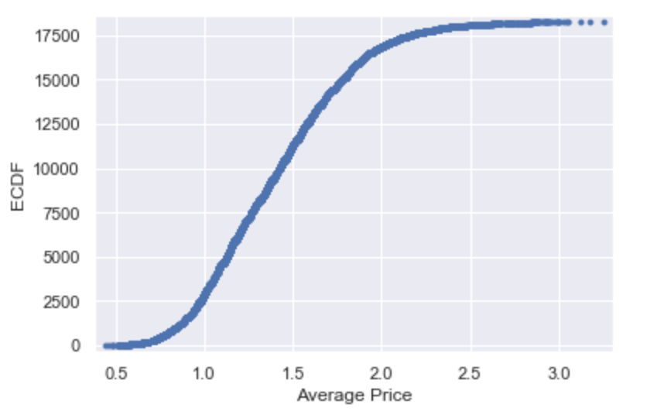
CDF
This plot of the cumulative distribution function (CDF) shows the probability that a random price will be less than or equal to a certain value.
$6 BILLIONS
$4 BILLIONS
$900,000

Slide 16
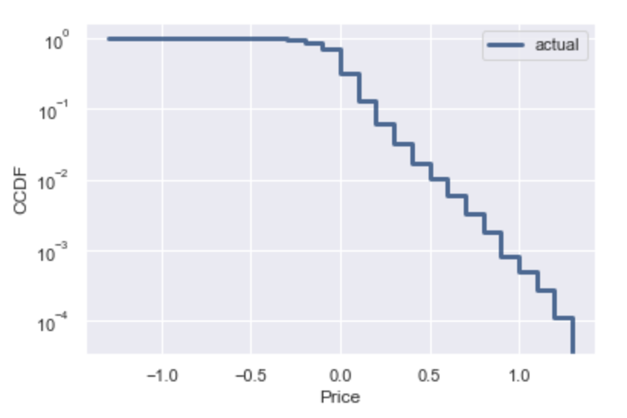
Complementary CDF
This answers the opposite question of the CDF, i.e., how likely is it that a random price will fall above a certain level.
$6 BILLIONS
$4 BILLIONS
$900,000

Slide 17
Drilldown on
Organic vs. Conventional Avocados

Slide 18
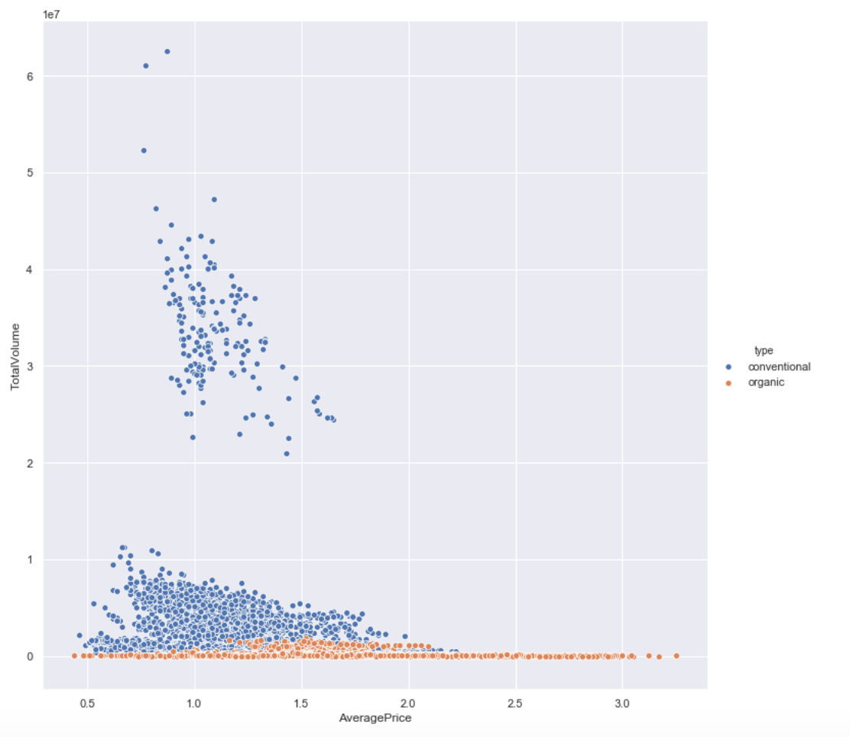
Scatter Plot of Types of Avocados Sold
The number of conventional avocados being sold don’t always seem to be dependent on price.
$6 BILLIONS
$4 BILLIONS
$900,000

Slide 19
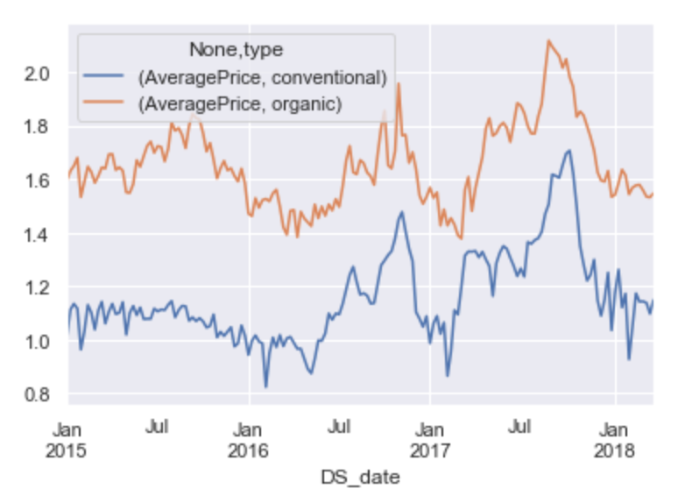
Time Series of Price Trends
The price of organic avocados seems to follow a similar line as the price of conventional avocados.
$6 BILLIONS
$4 BILLIONS
$900,000

Slide 20
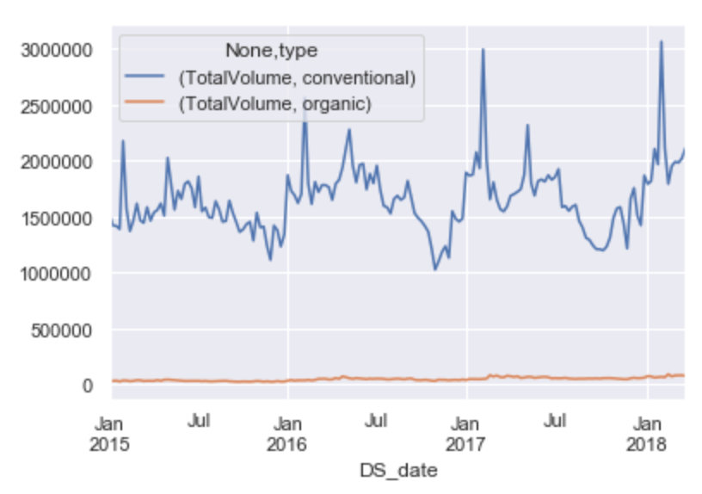
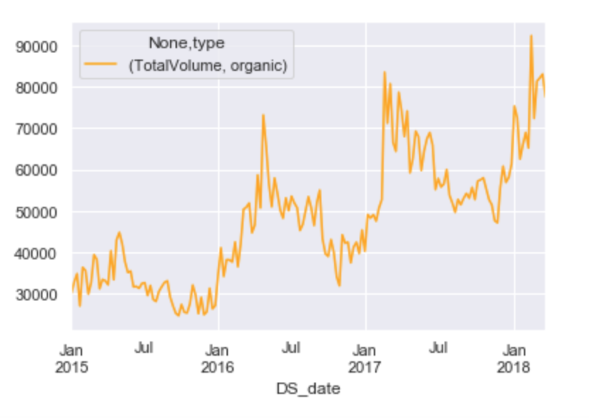
Volume Sold over Time
Both conventional (blue line) and organic (orange line) avocados have had increases in sales since Jan. 2015.
It’s important to note that these charts are on different scales.
$6 BILLIONS
$4 BILLIONS
$900,000

Slide 21
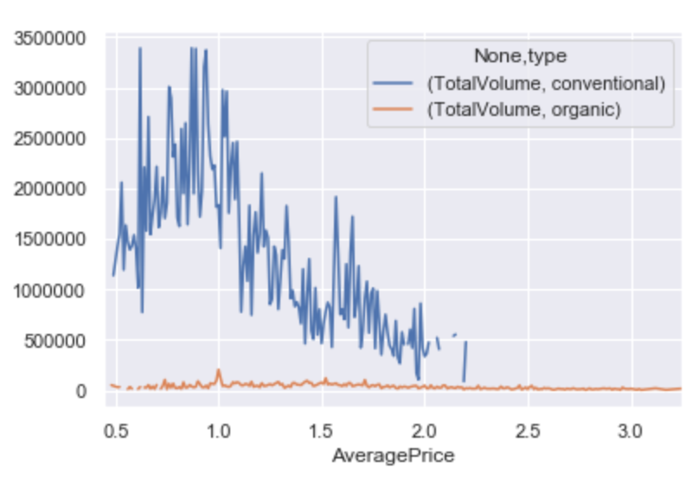
Volume Sold and Price
The volume of conventional avocados sold seem to peak at or below the $1.10 mark.
Organic avocados have an increase in their sales around $1.
$6 BILLIONS
$4 BILLIONS
$900,000

Slide 22
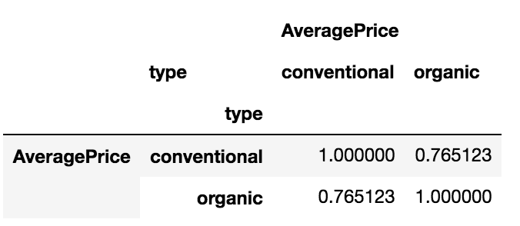
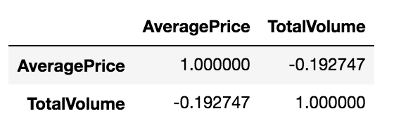
Correlation
The price of conventional and organic avocados have a strong positive correlation, 76%, which supports the hypothesis that their sales are related.
Average price and total volume (for all avocados) have a negative correlation, which means that in general, a decrease in sales occurs at the same time as an increase in avocado prices.
$6 BILLIONS
$4 BILLIONS

Slide 23
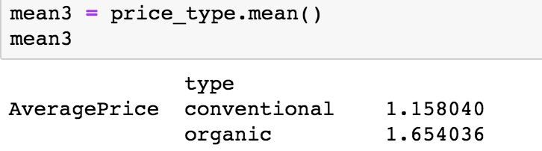
Central Tendency
On average, organic avocados cost $0.50 more than conventional avocados.
$6 BILLIONS
$4 BILLIONS

Slide 24
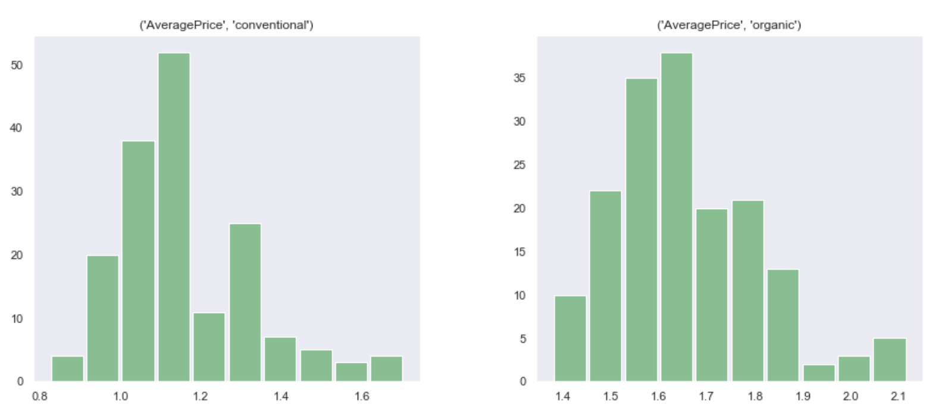
Histograms of Organic and Conventional Prices
Both organic prices and conventional prices have right skews, but each has a different frequency peak.
$6 BILLIONS
$4 BILLIONS
$900,000

Slide 25
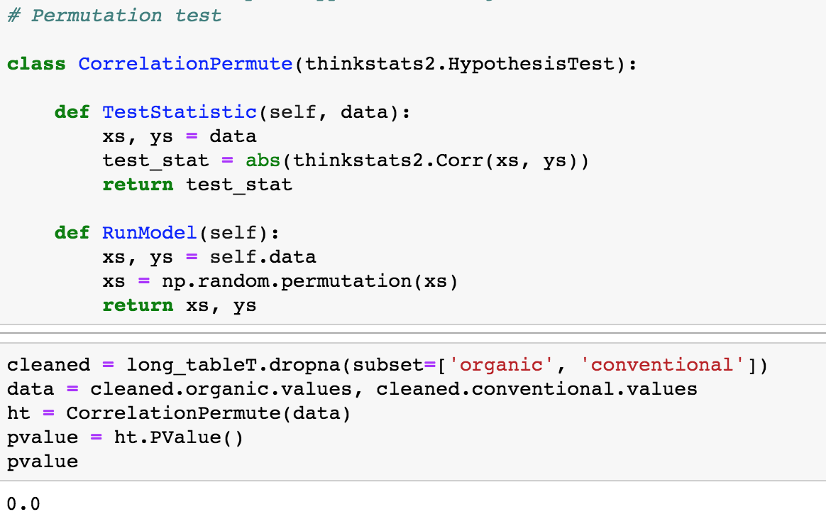
Permutation Test
The reported p-value is 0, which means that in 1000 trials we didn't see a correlation, under the null hypothesis, that exceeded the observed correlation. That means that the p-value is probably smaller than 1/1000 , but it is not actually 0.
$6 BILLIONS
$4 BILLIONS
$900,000

Slide 26
Linear Regression
The price of conventional avocados is growing faster than the price of organic avocados.
$6 BILLIONS
$4 BILLIONS
$900,000

Slide 27
Conclusions
Organic avocados cost $.050 more on average. However, the price of conventional avocados is increasing more rapidly than the price of organic avocados.
76% of the variation in the price of organic avocados correlates with the price of conventional avocados.
Price and the number of avocados sold have a negative correlation.

